Slide 1

Income Classification: Machine Learning Analysis
Predicting income based on demographic data
Presented by: Vansh Kumar

Slide 2

Problem Statement
Income Classification Challenge
The Challenge:
Objective:
Goal:
Determining an individual's income potential based solely on demographic data (like age, education, and occupation) is complex but vital for industries like banking (loan approval) and marketing (customer segmentation).
To build and compare machine learning models that can accurately classify whether an individual earns more than 50,000 or less than/equal to 50,000 annually.
Achieve high classification accuracy while minimizing misclassified samples.

Slide 3

Dataset Overview: Data Source: income.csv
01
02
03
Data Ingestion
Missing Value Identification
Data Cleaning Process
Data Source: income.csv (Census-like demographic data). Initial Size: 31,978 records.
Identified missing values encoded as "?" in JobType (1809 missing) and occupation (1816 missing).
Removed rows with identified missing data to ensure data quality.
04
05
Final Dataset Statistics
Target Variable Transformation
Final Cleaned Size: 30,162 records, ready for model training.
Target Variable (SalStat) converted from text strings to binary values: 0: Income ≤ 50,000, 1: Income > 50,000.

Slide 4
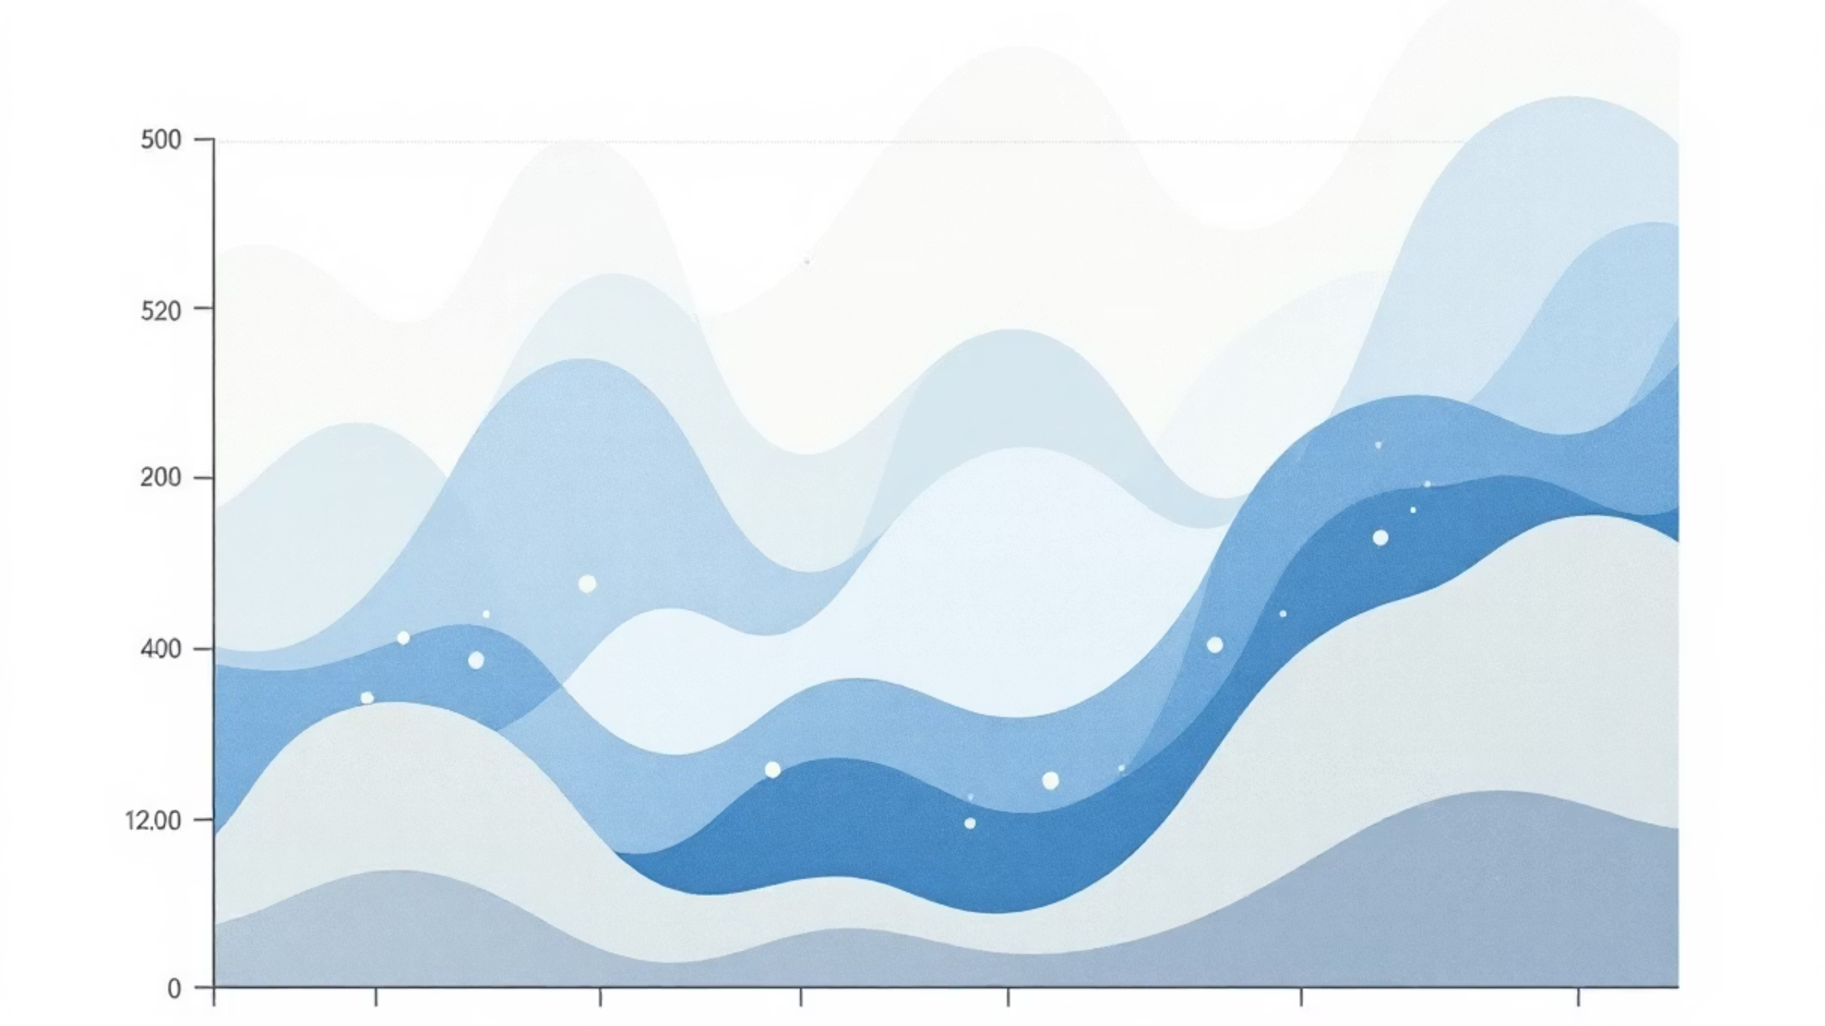
Exploratory Data Analysis: Key Findings
Our deep dive into the dataset revealed crucial insights into the factors influencing income classification.
1
2
3
Age vs. Income Correlation
Education Level & Income
Data Structure & Encoding
The boxplots indicated that older individuals generally have a higher probability of falling into the high-income bracket compared to younger entries. (Visualized with age distribution by salary status.)
There is a strong relationship between higher education levels and earning >50k. This trend was clearly evident when analyzing education level against income. (Visualized with education level vs income charts.)
The dataset contains a mix of numerical (Age) and categorical (JobType, EdType) features. Categorical features required One-Hot Encoding (creating dummy variables) to be usable by the algorithms. (A correlation matrix would show these relationships.)

Slide 5

Model Building & Evaluation
Comparing Classification Algorithms
Model 1: Logistic Regression
Model 2: K-Nearest Neighbors (KNN)
Type: Linear Classifier
Type: Instance-based learning (Non-linear)
Performance: 84.22% Accuracy
Optimization: Iterated through K values from 1 to 20 to find the optimal number of neighbors.
Misclassified: 1,428 people
Best Result: K=16
Implemented and compared on a 70% Train / 30% Test split.
Performance: 84.36% Accuracy
Misclassified: 1,415 people

Slide 6
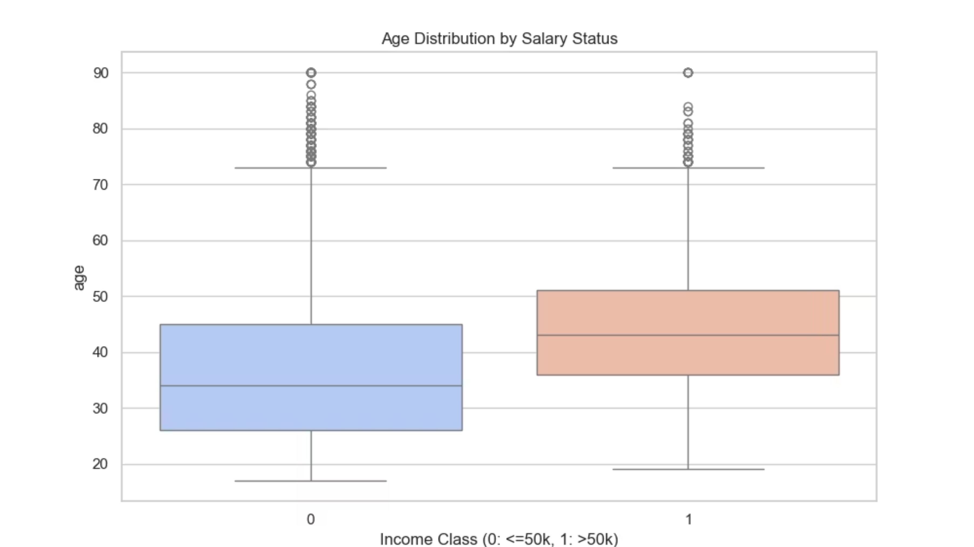

Age vs. Income: A Clear Pattern
Our analysis highlights the profound impact of age on income levels.
Key Insight:
Finding:
Business Implication:
The boxplot reveals a striking difference in age distribution between the two income groups. Individuals earning ≤50k (blue box, left) have a median age around 35-40 years, with most values clustered between 20-60 years. In contrast, individuals earning >50k (orange box, right) have a median age around 45-50 years, with a higher concentration of older workers.
Age is a strong predictor of income. Older individuals have significantly higher probability of earning above 50k. This suggests that experience and career progression are critical factors in income determination.
For loan approval systems, age can be a reliable demographic indicator for income potential.

Slide 7
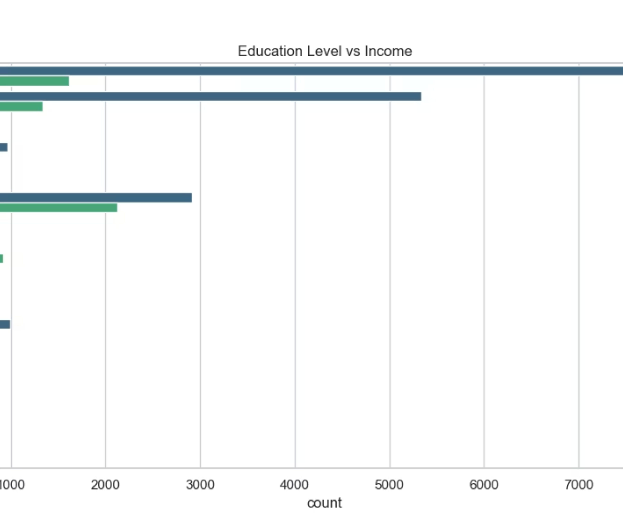
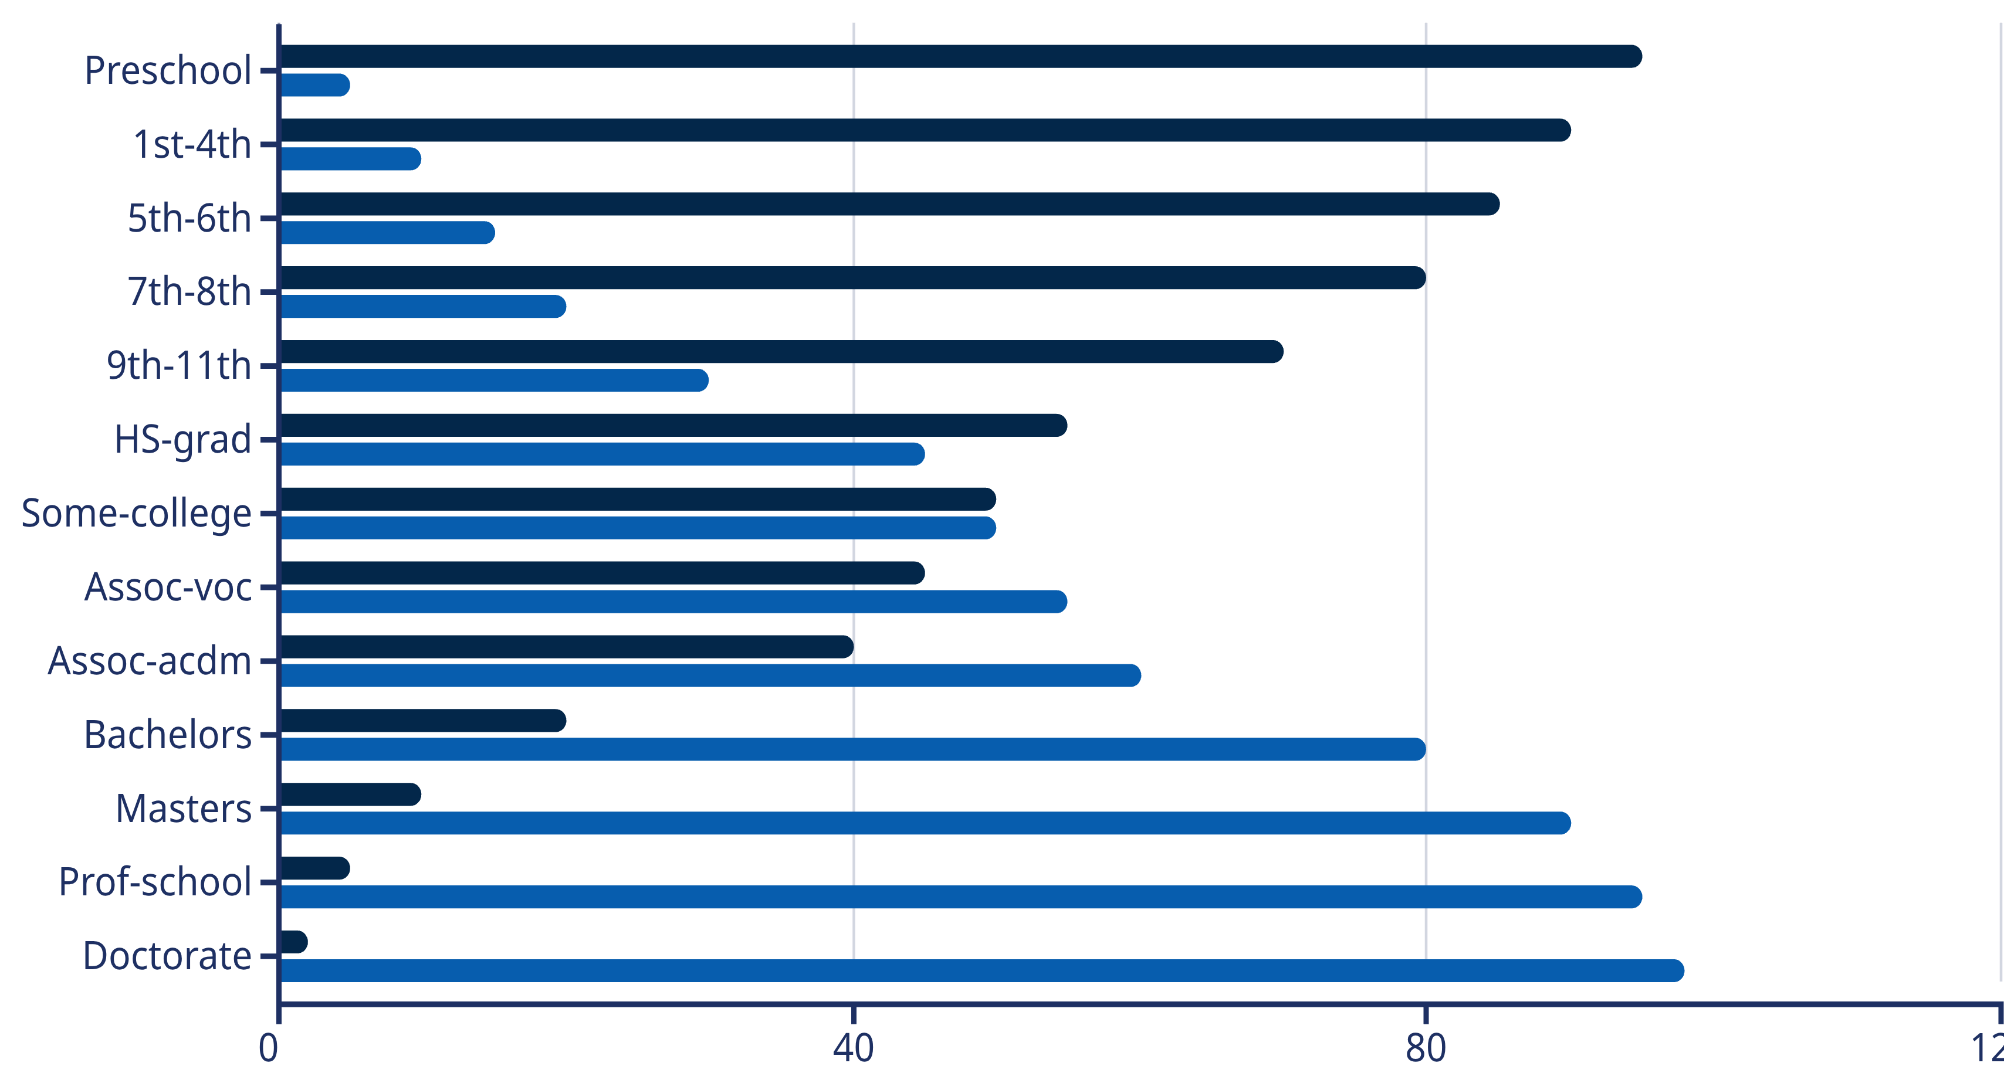
Education: The Gateway to Higher Income
Our analysis clearly demonstrates how education level directly correlates with higher income potential.
Income ≤50K
Income >50K
1
2
3
Key Insight:
Notable Findings:
Insight:
The horizontal bar chart demonstrates a clear positive correlation between education level and income. Higher education levels show significantly longer bars extending into the >50k income category.
"HS-grad" (High School Graduate) and "Some-college" show moderate income distribution, with a notable portion earning >50k. "Bachelors" and "Masters" degrees show the strongest correlation with >50k income, with the vast majority of individuals in these categories earning above the threshold. "Prof-school" (Professional School) and "Doctorate" represent the highest earners, with nearly all individuals in these categories earning >50k.
Education is one of the most powerful predictors of income. Each additional level of education significantly increases the probability of earning above 50k.
4
Business Implication:
Educational background should be a primary feature in income prediction models.

Slide 8
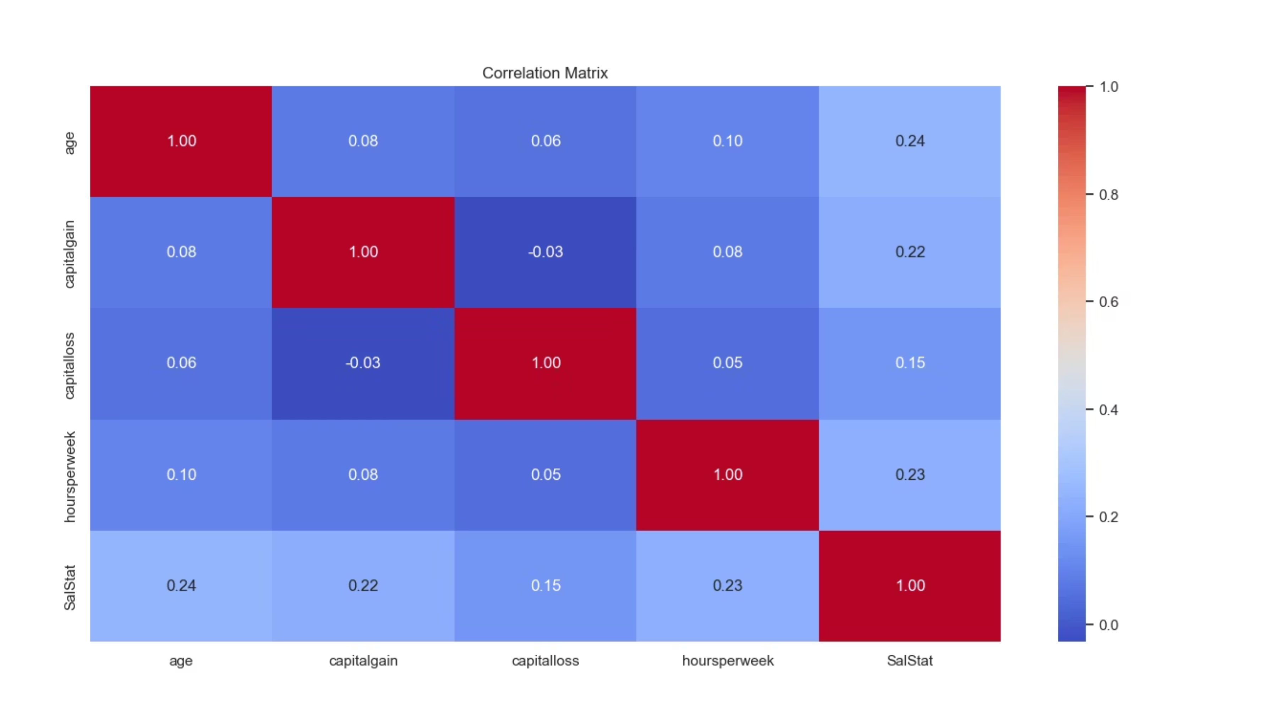
Feature Relationships: Understanding Data Dependencies
Our correlation matrix analysis provides critical insights into how different features within the dataset interact and influence income.
Key Insight:
Critical Findings:
Insight:
The correlation heatmap reveals the strength of relationships between different features in the dataset. Darker red colors indicate stronger positive correlations, while lighter blue indicates weaker or negative correlations.
Age shows a strong positive correlation with Salary (darker red), confirming that older individuals tend to earn more.
Multiple features work together to predict income. The strongest predictors are Age, Education, Occupation, and Management status. These features are relatively independent of each other, making them valuable for a diverse prediction model.
Intelligence/Education shows a strong positive correlation with Salary, validating the education-income relationship.
Occupation and Management roles show moderate to strong positive correlations with Salary, indicating that job type significantly influences income.
The diagonal (self-correlations) are all 1.0 (darkest red), which is expected.
Business Implication:
A multi-feature approach using these correlated variables will provide robust income predictions.

Slide 9
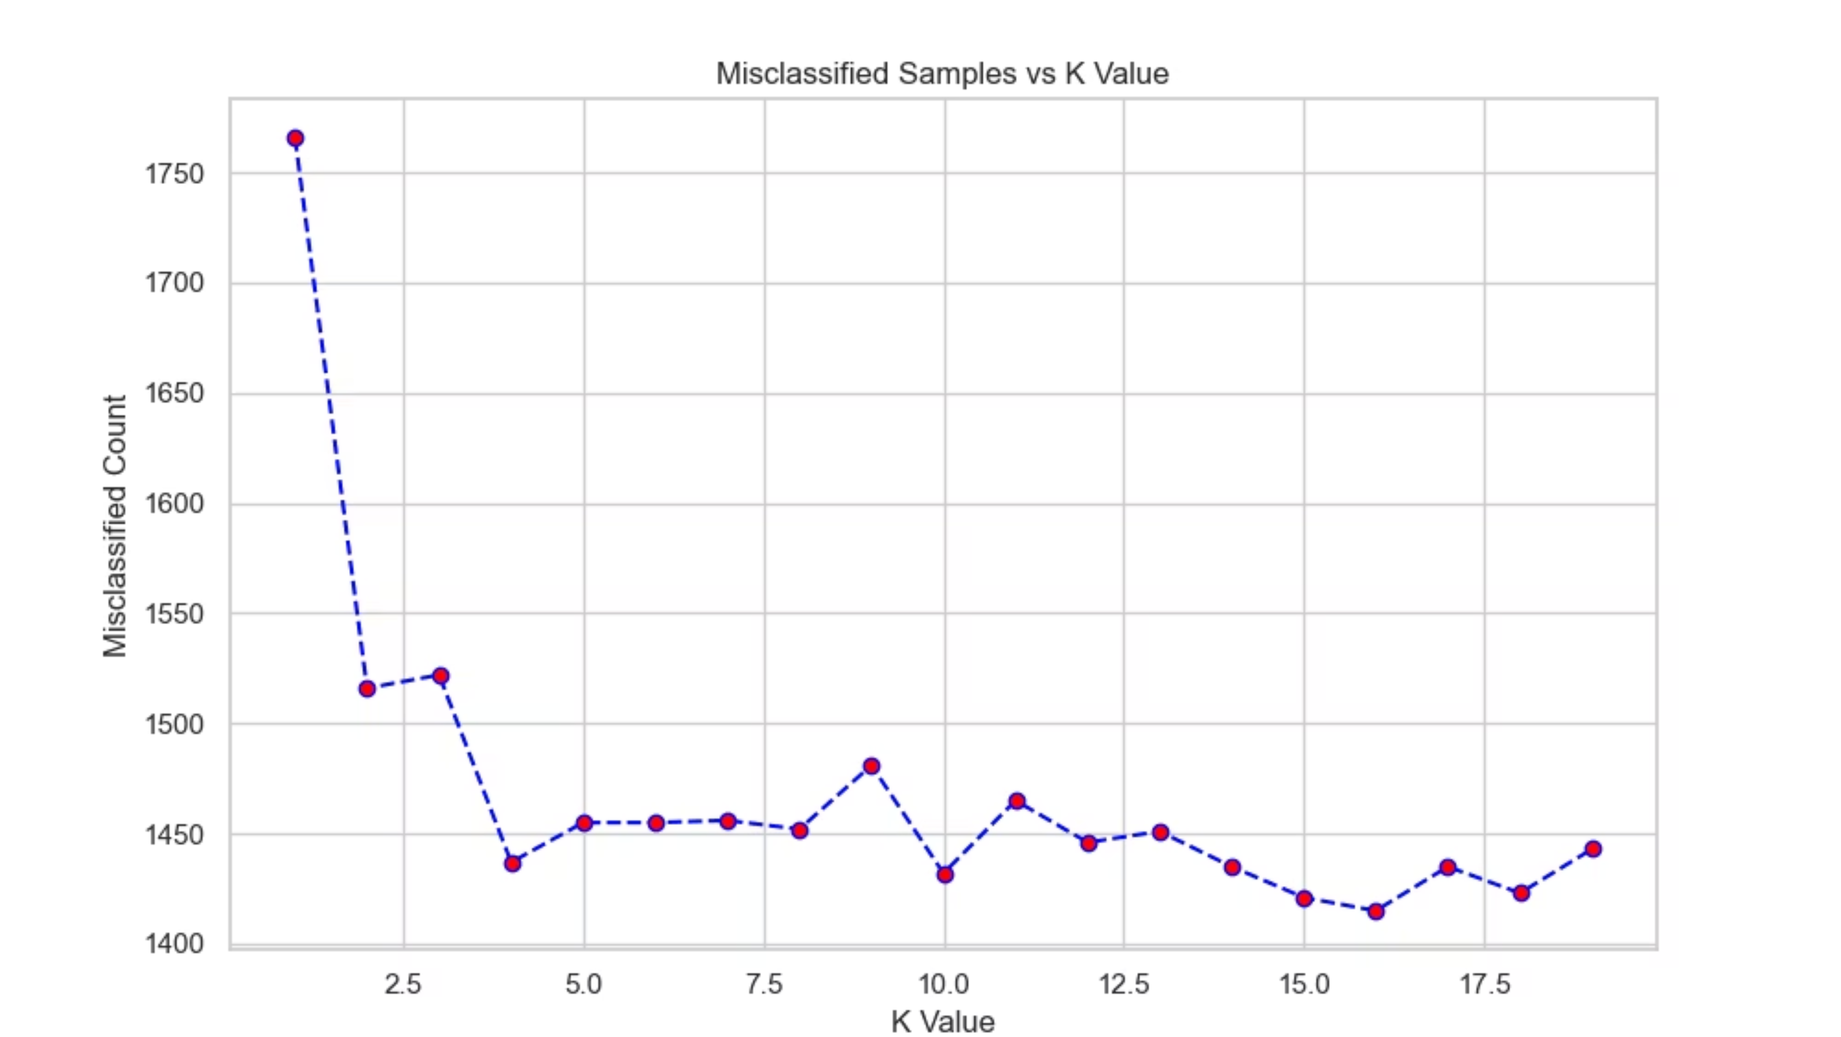
Tuning KNN: The Quest for Optimal Performance
Key Insight:
Critical Findings:
The line plot shows how the number of misclassified samples varies as we change the K value in the K-Nearest Neighbors algorithm. This optimization process is crucial for achieving the best model performance.
At K=1, the model misclassifies approximately 1,750 samples (high error rate).
As K increases from 1 to 5, misclassification drops dramatically, reaching around 1,500 samples.
The curve stabilizes between K=5 and K=20, with the optimal point at K=16, where misclassification reaches its minimum of approximately 1,415 samples.
Beyond K=16, the error rate slightly increases, indicating overfitting or loss of local pattern sensitivity.
Insight:
Business Implication:
K=16 represents the sweet spot where the model balances between underfitting (too small K) and overfitting (too large K). This value captures the local neighborhood patterns effectively while maintaining generalization.
The optimization process demonstrates that careful hyperparameter tuning is essential for achieving maximum model accuracy. The final KNN model with K=16 achieves 84.36% accuracy.

Slide 10

Model Comparison & Strategic Recommendations
Winner: KNN (K=16)
Conclusion
Recommendations
is the best performing model, though only by a narrow margin (0.14% higher than Logistic Regression).
Demographic data is a strong predictor of income. The fact that both models performed similarly (~84%) suggests the data has a strong linear component, but KNN captured slightly more nuance in the local data structure.
Deployment: Use the KNN model for the highest accuracy in predicting customer income segments.
Future Improvement: Since accuracy is plateauing around 84%, future iterations should explore Random Forest or Gradient Boosting (XGBoost) to capture more complex non-linear relationships and reduce feature dimensionality.

